Slide 1
ACADEMY OF ENGINEERING AND AUTOMOTIVE
ELECTRICAL AND ELECTRONIC ENGINEERING
NETWORKS 4_ Week A_
Ronald van Buuren
April 2023

Slide 2
net4 in the net series
Net1: constant voltage & current (DC)
Net2: sinusoidal voltage & current (AC)
Net3: sinusoidal voltage & current (AC), variation in frequency
Net4: transient (switching) behavior of systems
1st order networks, DC source
1st order networks, switching DC source
Solving differential equations
Homogeneous solution
Complementary solution
Steady-state situation
Complementary solution for sinusoidal & exponential sources

Slide 3
switching behaviour
NET4: solve in time domain
Next year: solve in frequency domain
Laplace transformation

Slide 4
net4 program by week
1st order RC networks – (dis)charging – DC source
1st order RC networks – (dis)charging – switched DC source
RL networks – Steady-state DC
RL networks – Switched DC source
RC & RL networks – complementary solution
<spare week>
Sample Exam

Slide 5
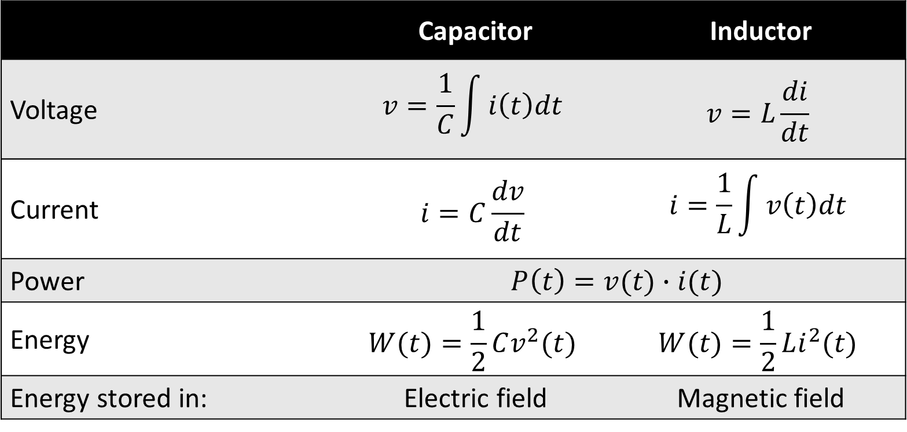
remember net2: Capacitor & inductor
 | Capacitor | Inductor
Voltage | $$v=\frac{1}{C}\int{i\left(t\right)dt}$$ | $$v=L\frac{di}{dt}$$
Current | $$i=C\frac{dv}{dt}$$ | $$i=\frac{1}{L}\int{v\left(t\right)dt}$$
Power | $$P\left(t\right)=v(t)∙i(t)$$
Energy | $$W(t)=\frac{1}{2}Cv^{2}(t)$$ | $$W(t)=\frac{1}{2}Li^{2}(t)$$
Energy stored in: | Electric field | Magnetic field

Slide 6
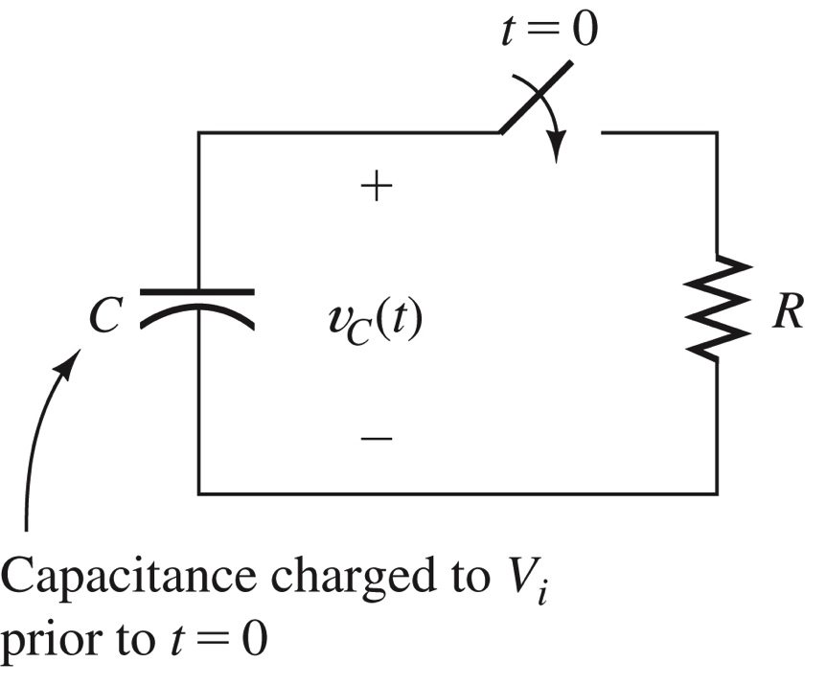
discharging a capacitor: estimations
Vi = 100 V
C = 10 µF
R = 1 MΩ

Slide 7
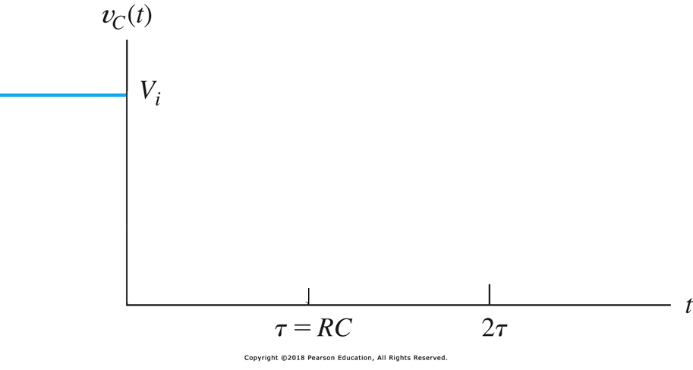
what will happen after time=0?

Slide 8
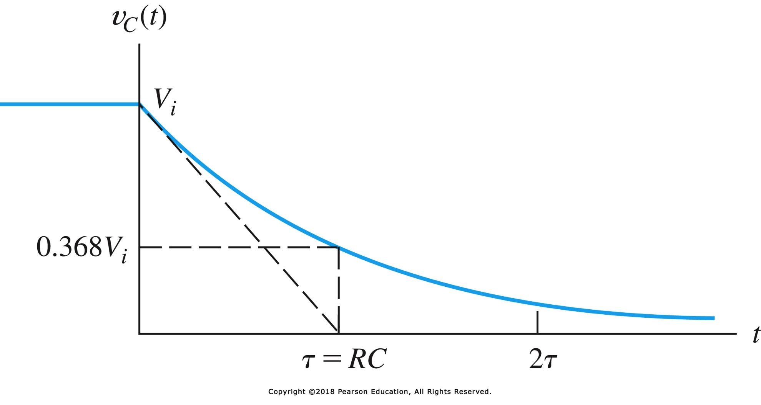
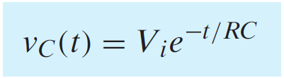

spoiler: it’s an exponential decay

Slide 9
discharging a capacitor: analytic solution
Vi = 100 V
C = 10 µF
R = 1 MΩ

Slide 10
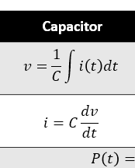

discharging a capacitor: kcl
KCL:
sum of currents = 0
Vi = 100 V
C = 10 µF
R = 1 MΩ

Slide 11
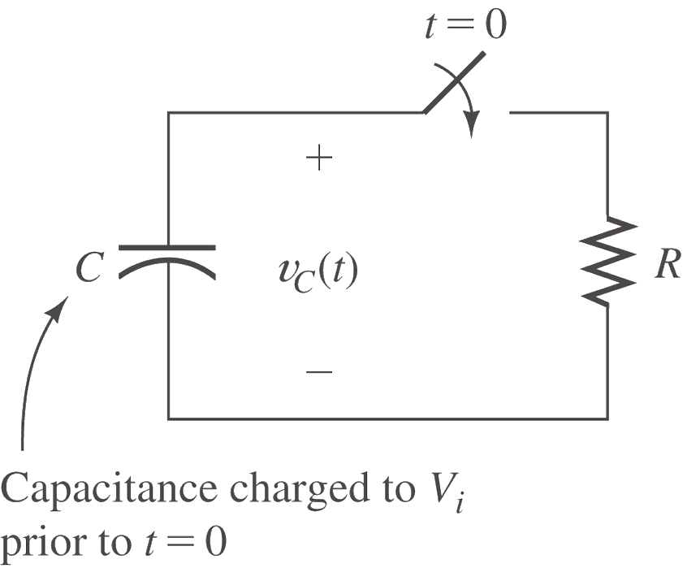
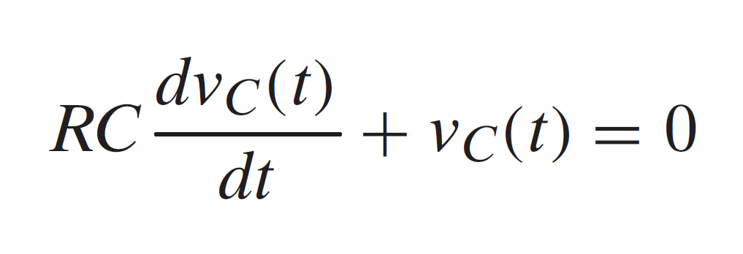
Differential equation

Slide 12

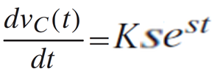

Differential equation: how to solve
Educated guess v_{C}=Ke^{st}
Forget about K=0 ☺

Slide 13
indeed it’s an exponential decay

Slide 14
how did you find K=V_{I}?

Slide 15

Look at t=0 s: must be continuous

Slide 16
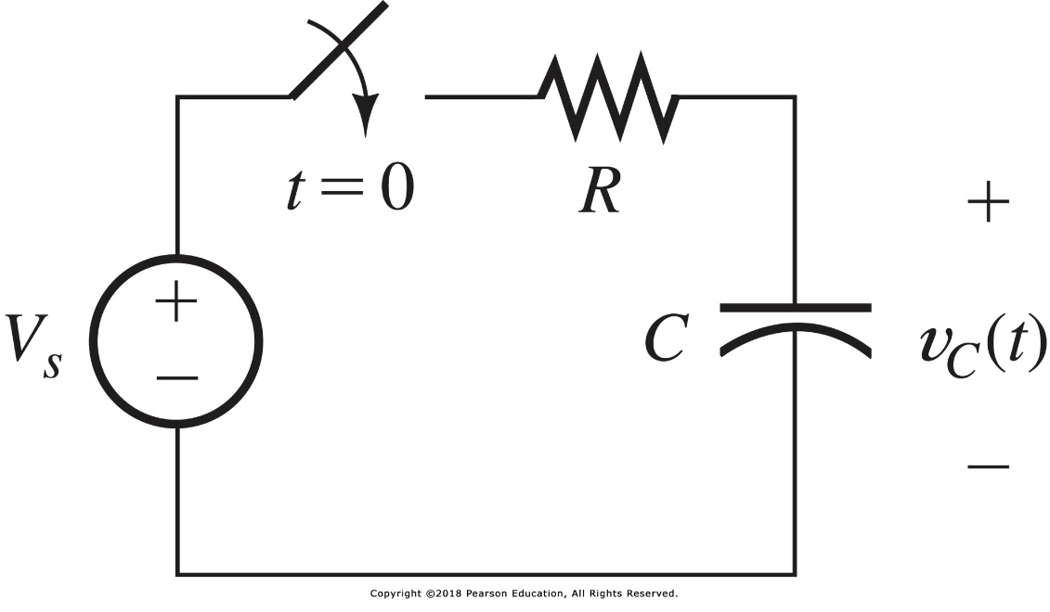
charging a capacitor

Slide 17
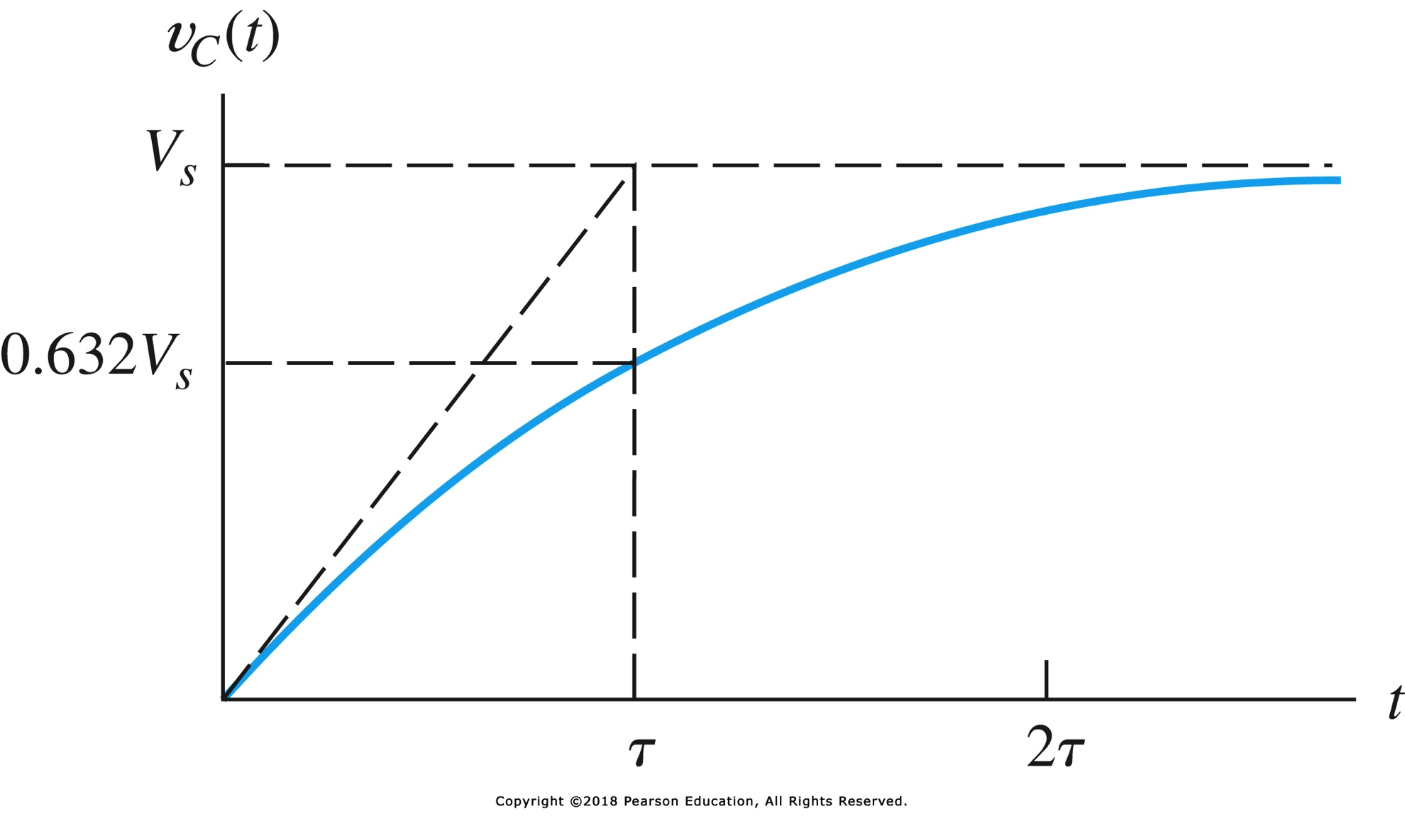

charging a capacitor

Slide 18
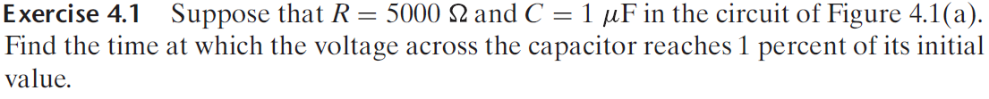
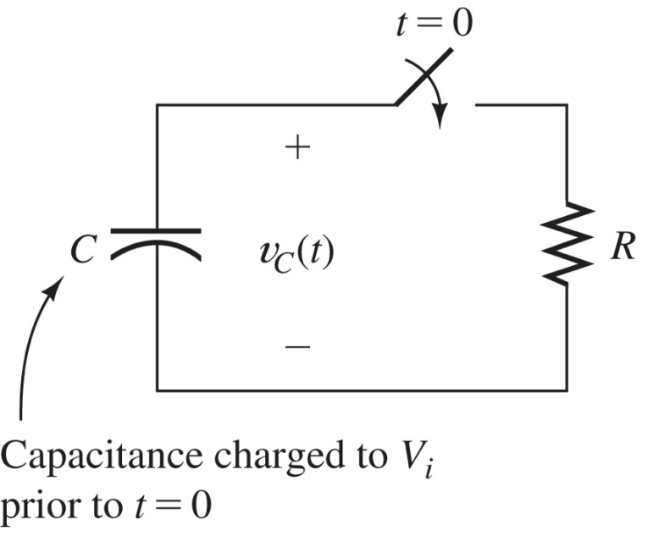
exercise 4.1

Slide 19

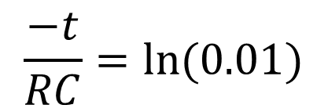
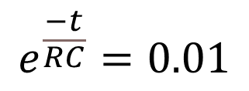
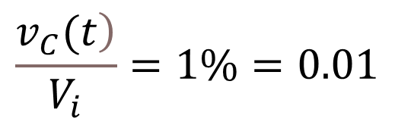
exercise 4.1 - solution
$$\frac{\left.v_{C}(t\right)}{V_{i}}=1\%=0.01$$
$$e^{\frac{−t}{RC}}=0.01$$
$$\left.t=−RC·ln{(}0.01\right)$$
$$\frac{−t}{RC}=ln(0.01)$$

Slide 20
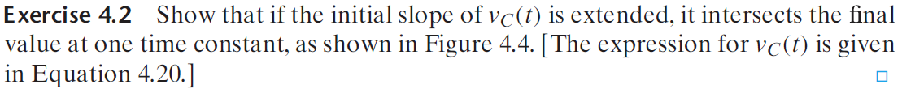
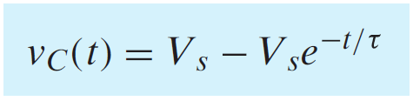

exercise 4.2

Slide 21
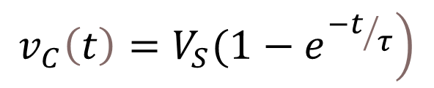

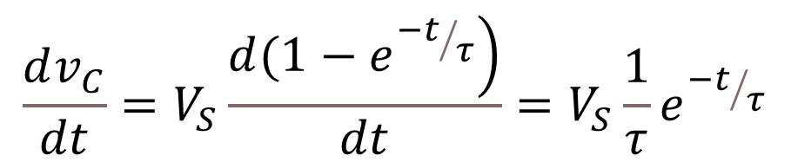
exercise 4.2 – solution step 1
$$\left.v_{C}\left(t\right)=V_{S}(1−e^{{−t}/τ}\right)$$
$$\frac{dv_{C}}{dt}=V_{S}\frac{\left.d(1−e^{{−t}/τ}\right)}{dt}=V_{S}\frac{1}{τ}e^{{−t}/τ}$$
slope:
so, at t=0: slope =
$$\frac{V_{S}}{τ}$$

Slide 22
problems to finish before NEXT class
P4.2
P4.5
P4.7
P4.10
P4.11
P4.15

